Slide 1
Melanie Redman
President, A Way Home Canada
Stephen Gaetz
President, Canadian Observatory on Homelessness
Notes:
Title: A Way Home: Preventing and Tackling Youth Homelessness
Focus on building a movement for change.
Flash back to 2013 and name some of the conditions.
For each major area how we have set about to transform things.
Who is at the table?
Launch of A Way Home coalition – Development of vision paper
Organizing work into constellations of activity to leverage strengths of coalition members.
Role of Research and Evidence – co-creation of a YH research agenda
Role of the sector – process they went through to develop a theory of change.
Role of government relations
International engagement
Social innovation

Slide 2
We believe we can prevent and end youth homelessness
In Canada. This is the story of how we’re doing it.

Slide 3
ABOUT US:
A Way Home is a national coalition reimagining solutions to youth homelessness through transformations in policy, practice and planning. We also lead the National Learning Community on Youth Homelessness.
Notes:
Talk about AWH coalitions globally.

Slide 4
ABOUT US:
The Canadian Observatory on Homelessness (COH) is a research and policy partnership working to conduct and mobilize research designed to have an impact on solutions to homelessness.

Slide 5
Part 1
Understanding Youth Homelessness in Canada

Slide 6
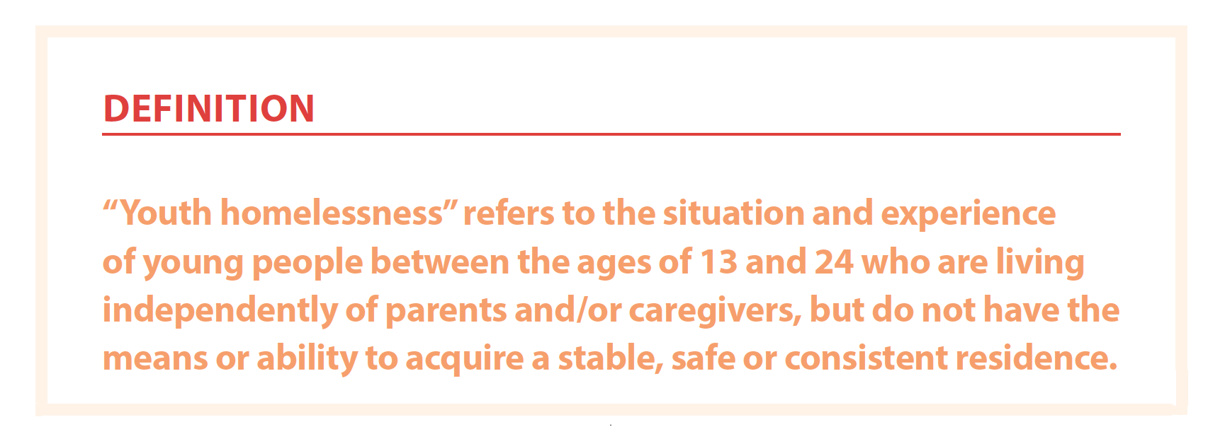

Slide 7
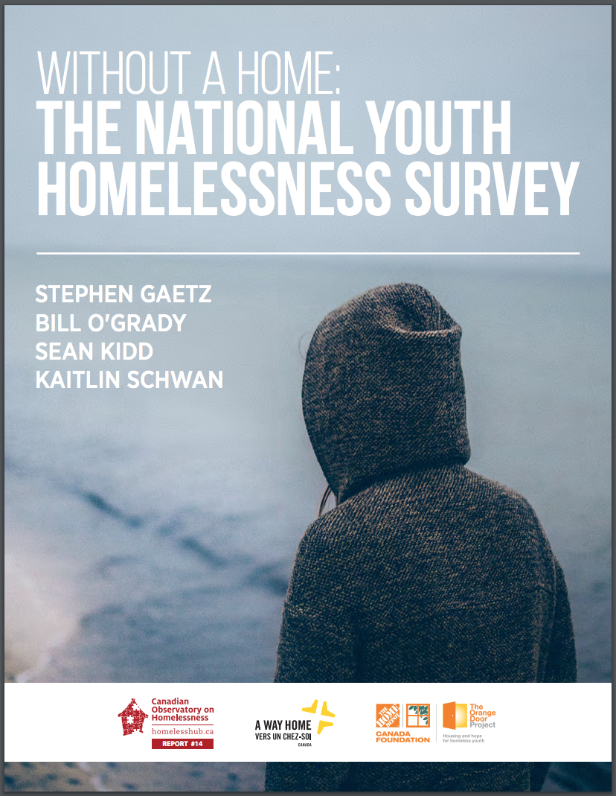
Survey Results
From the first Without a Home study
2016
Stephen Gaetz, Bill O’Grady, Sean Kidd & Kaitlin Schwan. (2016). Without a Home: The National Youth Homelessness Survey. Toronto: Canadian Observatory on Homelessness Press.

Slide 8
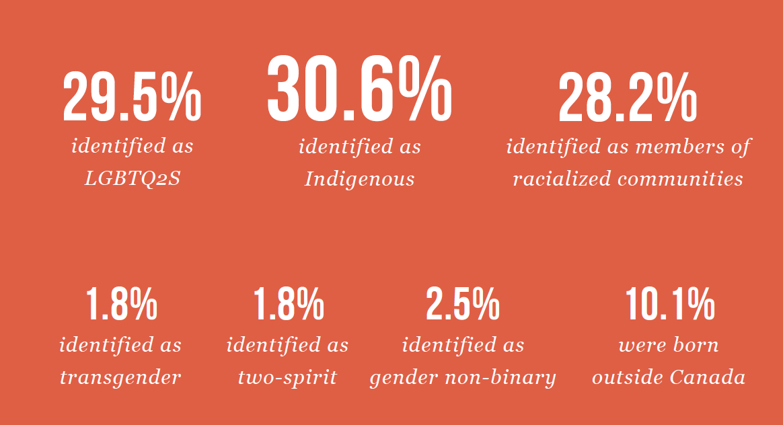
Gaetz, et al., (2016):6
Notes:
STEVE

Slide 9
Age of first experience of homelessness
Notes:
STEVE

Slide 10
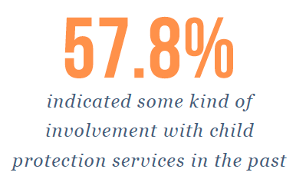
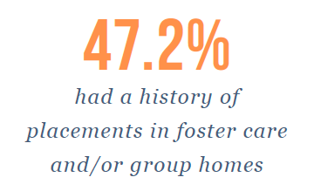
Involvement with Child Protection services
30.9% were in group homes
Notes:
STEVE

Slide 11
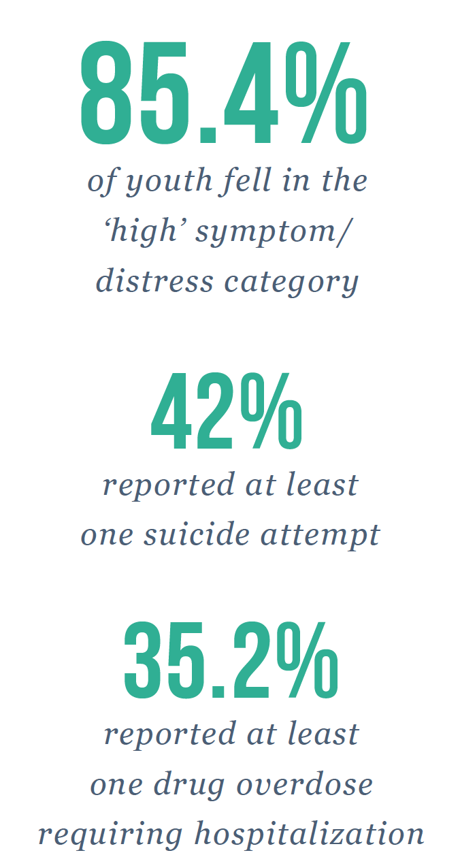
Mental Health and Well-Being
Findings indicated that a total of 85.4% (942) of the youth fell in the ‘high’ symptom/ distress category. This is indicative, in the general Canadian population, of youth midway between inpatient and outpatient psychiatric care levels.
Notes:
STEVE

Slide 12
PROLONGED EXPERIENCES OF HOMELESSNESS
Criminal Victimization
Exposure to street violence makes the impact of pre-street adversity much less relevant. This suggests that whether prior to becoming homeless young people were exposed to adversity or not, experiencing violence while homeless has a ‘leveling’ effect on youth mental health risk.
Exposure to sexual and physical violence on the street made youth over three times as likely to be in the high mental health risk group.
Notes:
STEVE

Slide 13
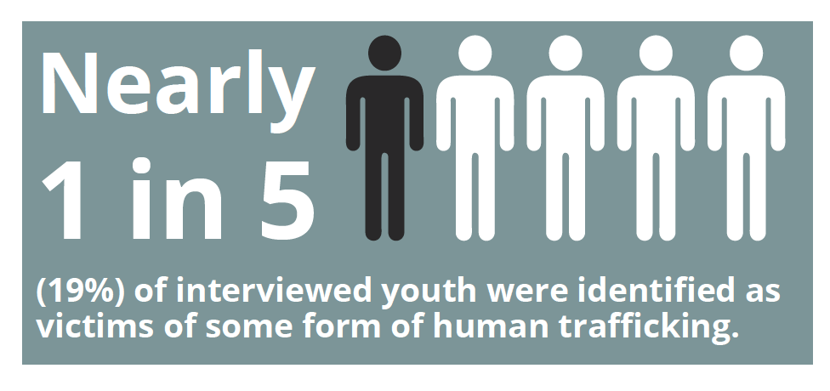
Exploitation and Sex Trafficking

Slide 14
Pathways off the streets
and
Exits from Homelessness
Notes:
STEVE
So based on what we know about the impact of homelessness on young people, we need to consider how we are responding to the problem, and whether this response is adequate.
Research on outcomes for youth when they exit homelessness is compelling, but not in a positive way. It shows young people do not do well.
They aren’t recovering
PTSD
Living in extreme poverty.
Not engaging in work or in school
Are not overcoming social exclusion
Even the At Home/Chez Soi research shows this.

Slide 15
Research and Data point to important conclusions
First, we are waiting too long to intervene.
Second, experience of homelessness has a devastating impact on health, safety, mental health and well-being.
Third, some young people – Indigenous, LGBTQ2S, newcomer youth – experience additional burden of discrimination and exclusion.
Fourth, the emergency response does not prevent or end youth homelessness.
Fifth, our public systems are failing to prevent youth homelessness.
Sixth, when young people exit homelessness, recovery and inclusion are challenging.
Seventh, people with lived experience of youth homeless strongly profess the need to shift to prevention.

Slide 16
The change we want to see …
Emergency
Response
Housing and Supports
Prevention
Notes:
MELANIE
There are three things you can do to address homelessness.
First you can prevent it.
Second, even with prevention, some people will slip through the cracks and you will need emergency services
Third, you need to move people out of homelessness with the necessary supports to ensure they don’t become homeless again.
Unfortunately, the bulk of our efforts and investment in Canada are in the middle - the crisis response. This includes for the most part emergency shelters and day programs, designed to address the immediate needs of young people for shelter and perhaps food.
This imbalance in how we invest in, and respond to, homelessness is highly problematic, especially considering the well-being of young people. While emergency supports are necessary in providing crisis relief, they do little to meaningfully prevent, reduce, or end youth homelessness, nor address the most negative outcomes of this experience.

Slide 17
The change we want to see …
Emergency
Response
Housing and Supports
Emergency
Response
Prevention
Notes:
MELANIE
Where we want to get to is something that looks more like this, with the bulk of investment in prevention and sustained exits from homelessness, thus ensuring the best possible outcomes for young people and their families.

Slide 18
Part 2
Looking Back

Slide 19
2013
What were the conditions?

Slide 20
No national organization focused on youth homelessness
Youth homelessness not on the radar within government or in most municipalities
Canadian Alliance to End Youth Homelessness emerging
National Learning Community on Youth Homelessness
Canadian Observatory on Homelessness
Working to create momentum for shift to prevention
Published key documents:
Youth Homelessness in Canada
Coming of Age: Reimagining the Response to Youth Homelessness

Slide 21
An emerging idea:
Develop a national coalition to prevent and end youth homelessness

Slide 22
Key National Partners

Slide 23
Launching:

Slide 25
Part 3
Building a movement for Change through COLLECTIVE IMPACT!

Slide 26
Changing how we work
Collective Impact involves a group of relevant actors from different sectors working together to address a major challenge by developing and working toward a common goal that fundamentally changes outcomes for a population.

Slide 27
Preconditions
For Collective Impact
1. Influential Leaders
2. A Sense of Urgency
3. Building trust
4. Adequate Resources

Slide 28
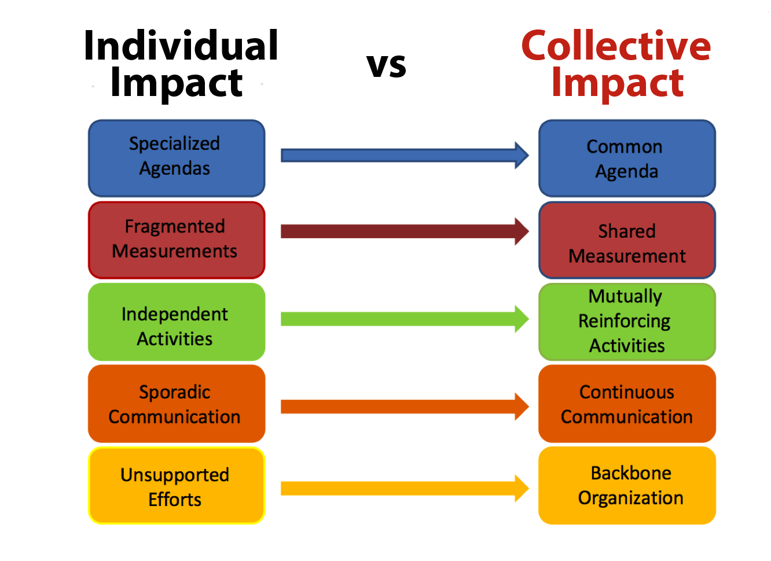

Slide 30
Collaboration is NOT the same as
Collective Impact

Slide 31
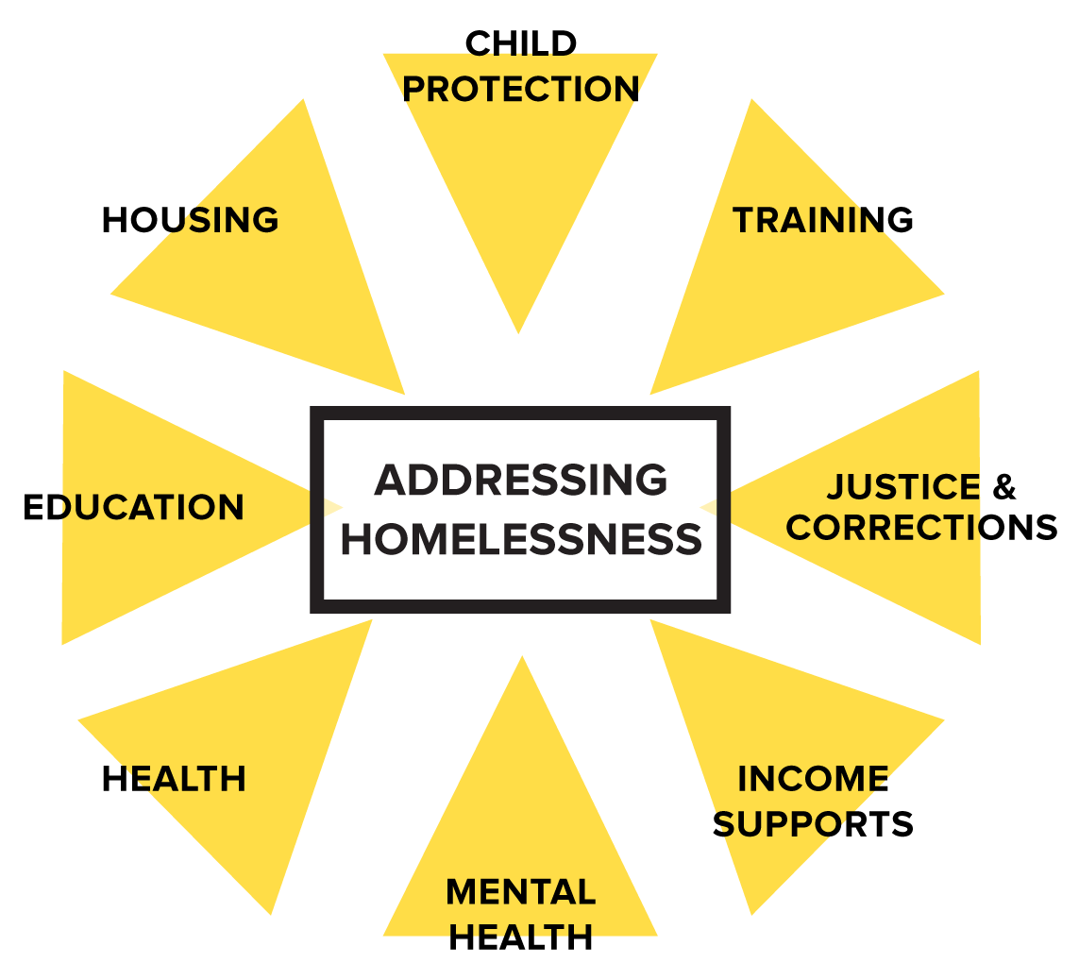
Recognizing youth
homelessness
as a fusion policy issue

Slide 32
Considering who is at the table
Notes:
Highlight the role of unusual suspects.

Slide 33
Developing a shared VISION and AGENDA
Supporting a shift from a crisis response to PREVENTION

Slide 34
Sequence of Required Events
Context
Logic Model
Theory of Change
Underlying Assumptions
elements
Long term Outcomes
Intermediate Outcomes

Slide 35
Redefining the role of the service sector

Slide 36
Organizing philanthropy:
AWH Funders Table

Slide 37
Foregrounding people with lived experience

Slide 38
Shifting to a
Human Rights
orientation

Slide 39
Co-creating a research agenda
Collaboration with the

Slide 40
Research Agenda
Key Priorities – 2014-16
Point in Time Count Toolkit
Definition of youth homelessness
Program Model Case Studies
National Youth Homelessness Survey
Data Management Support
Prevention Framework
Cost Effectiveness Study
Policy Briefs

Slide 41
Enhancing government relations
Federal c
Provincial c
Municipal c
Indigenous c

Slide 42
Engaging internationally
Europe
FEANTSA
European Observatory on Homelessness
A Way Home Europe
Housing First Europe Hub
United States
National Network
for Youth
Chapin-Hall
A Way Home America
American Bar Association
True Colors United
Global initiatives (including work in Central and South America, Africa & Asia)
Upstream International Living Lab
Institute on Global Homelessness
Covenant House International
Consortium for Street Children
Baker McKenzie
Australia
National Youth Commission
A Way Home Australia

Slide 43
Collective Impact:
The Dark Side

Slide 44
The Specialness Disease

Slide 46
Part 4
Supporting Systems Planning

Slide 49
Part 5
Fostering Social Innovation

Slide 50
Youth
Homelessness
Social Innovation Lab
Notes:
Melanie welcome and introduce everyone
AWHC and the COH acknowledge the location of this meeting on the traditional, unceded territories of the Algonquin nation.

Slide 51
Co-Leadership
Notes:
MELANIE

Slide 52
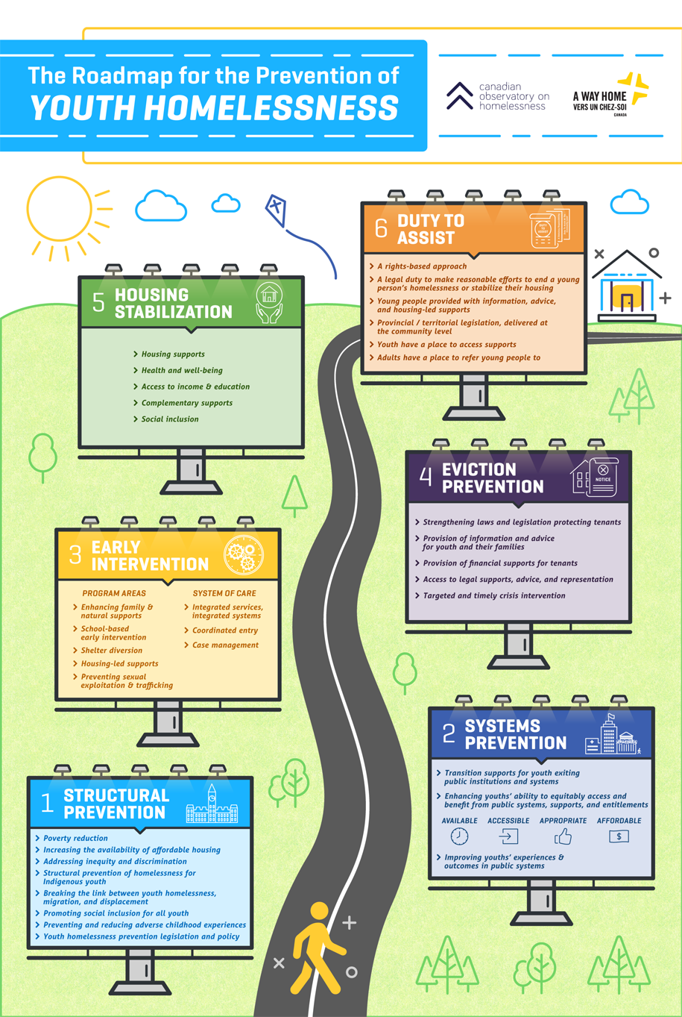
Notes:
MELANIE

Slide 53
Making the Shift brings together our collective body of work on the prevention of youth homelessness
Notes:
The desire for this kind of systems transformation informs our vision for the network.

Slide 54
Our work focuses on a singular goal: to conduct and mobilize quality research that supports governments, communities and service providers to make the shift from managing the crisis of youth homelessness, to a focus on prevention and enabling sustainable exits from homelessness.
Notes:
The objectives of MtS address both operational aspects of the MtS NCE, but also the societal changes we want to see. Ultimately, we want to see a dramatic reduction in youth homelessness, and better outcomes for young people who are at risk or who experience it.
The strategic objectives of MtS include:
1. Operationalize MtS as a true partnership between networks of researchers and end-users;
2. Implement a management and governance structure to support the innovative work of MtS and ensure progress and accountability;
3. Generate research on effective approaches to prevention and sustainable exits from homelessness;
4. Mobilize knowledge by leveraging high impact partnerships that foster systems transformation, ensuring key research evidence is integrated into policy, programs and practice;
5. Provide evidence and facilitate decision-making that will reduce the rates of youth homelessness and thereby its socioeconomic impacts;
6. Develop a cohort of highly qualified personnel in research and practice who develop and utilize skills to co-create and mobilize research evidence into effective policies and practices;
7. Achieve a more equitable, diverse, and inclusive Canadian research enterprise through the meaningful engagement of people with lived experience of youth homelessness.

Slide 55
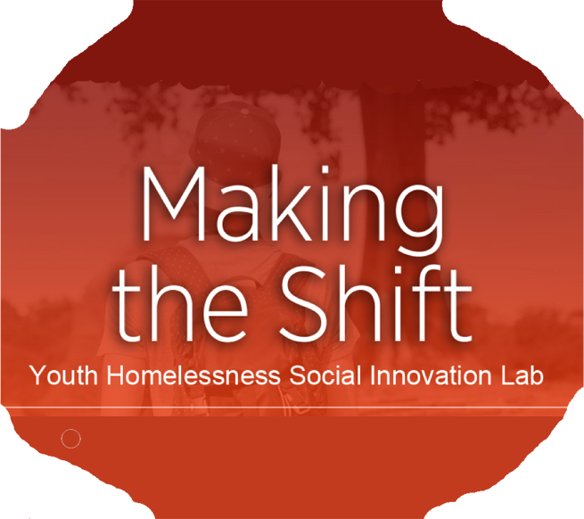
Web of
Research
Networks
Child protection
Resilience
Schools
Prevention
Sustainable Exits from Homelessness
HF4Yx
Housing
x
Disability
Inclusion
Indigenous
Health, Well-Being & Inclusion
Leveraging Data &
Technology
Addictions
Justice
Employment & Training
Policy
Notes:
MtS leverages a broad range of research centres and institutes with allied interest in youth homelessness, including the BRAIN (Big Data Research, Analytics, and Information Network (York University); Centre for Community Research, Learning and Action (Wilfred Laurier); Centre for Innovation in Information Visualization and Data Driven Design, and the NSERC funded Data Mining Lab (York University); Centre for Research on Children and Families (McGill); Centre for Urban Health Solutions (St. Michael’s Hospital, Toronto); Lawson Health Research Institute (Western); Resilience Research Centre (Dalhousie); School of Public Policy (U of Calgary); Waakebiness-Bryce Institute for Indigenous Health (U of Toronto); and Young Lives, Education and Global Good (York U). The SD and research theme leads all have established relationships with (and in some cases lead) the above research centres and institutes.

Slide 56
Partnerships
Within the Homelessness Sector
External to the Homelessness Sector
Hamilton
Regional
Indian
Centre
Notes:
For far too long we have relied on the homelessness sector to solve the problem of youth homelessness. The MtS change agenda necessitates high impact partnerships within the homelessness sector, but because the nature of the problem as a fusion policy issue, we need a broader engagement with partners to impact on the issue.

Slide 57
Making the Shift has funded
40 research projects across Canada focusing on the prevention of youth homelessness
Funded Research
Notes:
What are MtS Demonstration projects?
Demonstration projects blend experimental program delivery with research and evaluation. They allow for key learning to come forward by answering questions such as: are the needs of the target demographic being adequately met? What program adaptations might be needed? What can others learn from this intervention? Answers to these questions provide practitioners and researchers with critical data about their theories and practice.
For MtS DEMS, this means implementing programs in community settings and allowing simultaneous qualitative and quantitative data analysis. Each community site has a specific focus, with a dedicated research and evaluation team to track the data and collect feedback from program participants and staff. The national team closely monitors and guides the research and evaluation work being done at the community sites.

Slide 58
Employing design thinking, our demonstration projects are intended to expand our knowledge and understanding of innovative approaches to preventing and ending youth homelessness by identifying, developing, prototyping, testing, evaluating, and mobilizing innovations in policy and practice through the implementation of comprehensive demonstration projects.
Demonstration
Projects
Notes:
What are MtS Demonstration projects?
Demonstration projects blend experimental program delivery with research and evaluation. They allow for key learning to come forward by answering questions such as: are the needs of the target demographic being adequately met? What program adaptations might be needed? What can others learn from this intervention? Answers to these questions provide practitioners and researchers with critical data about their theories and practice.
For MtS DEMS, this means implementing programs in community settings and allowing simultaneous qualitative and quantitative data analysis. Each community site has a specific focus, with a dedicated research and evaluation team to track the data and collect feedback from program participants and staff. The national team closely monitors and guides the research and evaluation work being done at the community sites.

Slide 59
Program Design & Prototyping

Slide 60
Research and Evaluation
Research and Evaluation
Research:
Qualitative and quantitative methods
Outcomes tied to service and supports
For HF4Y - Randomized Control trial
Evaluation:
Developmental Evaluation
Outcomes Evaluation
Notes:
STEVE

Slide 61
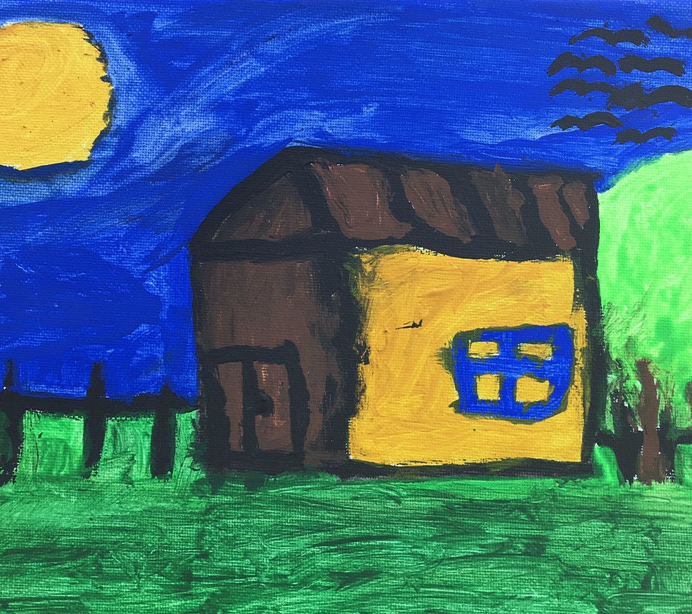
Nurturing an Iterative Relationship between Research and Practice
The cultures, values and practices of research and service organizations are profoundly different
This was an identifiable problem not only at the community (Demonstration Project level) but also within Making the Shift
Knowing when and how to push against the status quo is essential for seeding the ground for innovation
Notes:
What this means going forward: Nurturing, sustaining, and operationalizing a community of practice will be key to replicating and scaling this work. Program staff and senior leaders need to feel confident that they can rely on the advice, mentorship, and support of like-minded professionals. In the next phase of Making the Shift, we have prioritized enhancing linkages between our efforts to build a community of practice and technical training and assistance.

Slide 62
1
Enhancing Family and Natural Supports

Slide 63
To Find Out More ….

Slide 64
2
SCHOOL-BASED
Early Intervention

Slide 65
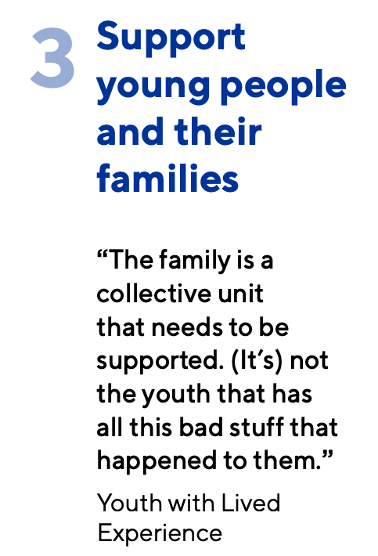
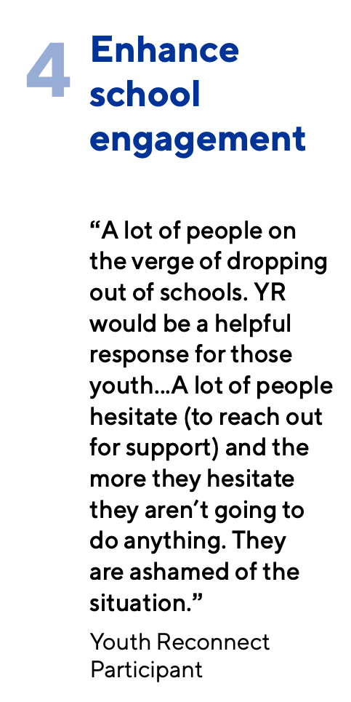

Slide 66
To find out more …

Slide 67
Helping youth exit homelessness for good!
3

Slide 68
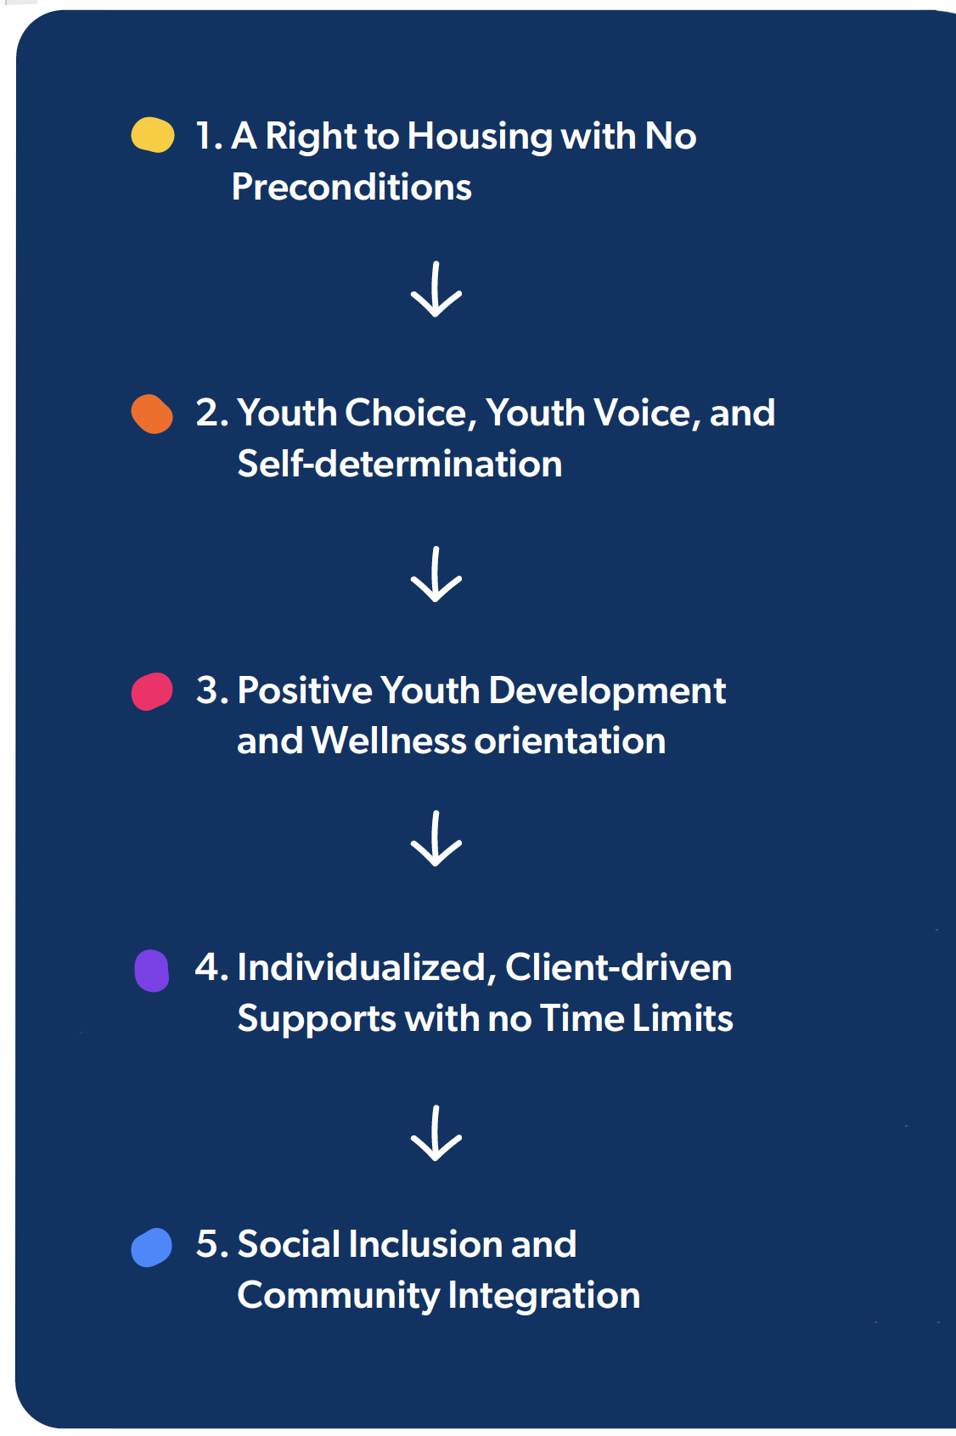
The importance of developing a response based on the needs of developing adolescents and young adults
Promoting housing stabilization, well-being, social inclusion and positive transitions to adulthood.
Notes:
Steve

Slide 69
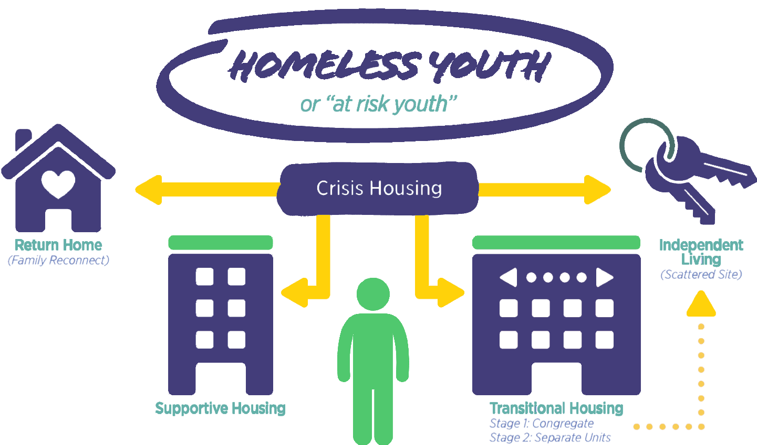
Models of Accommodation
for Housing First for Youth
The importance of developing a response based on the needs of developing adolescents and young adults
Notes:
Steve

Slide 70
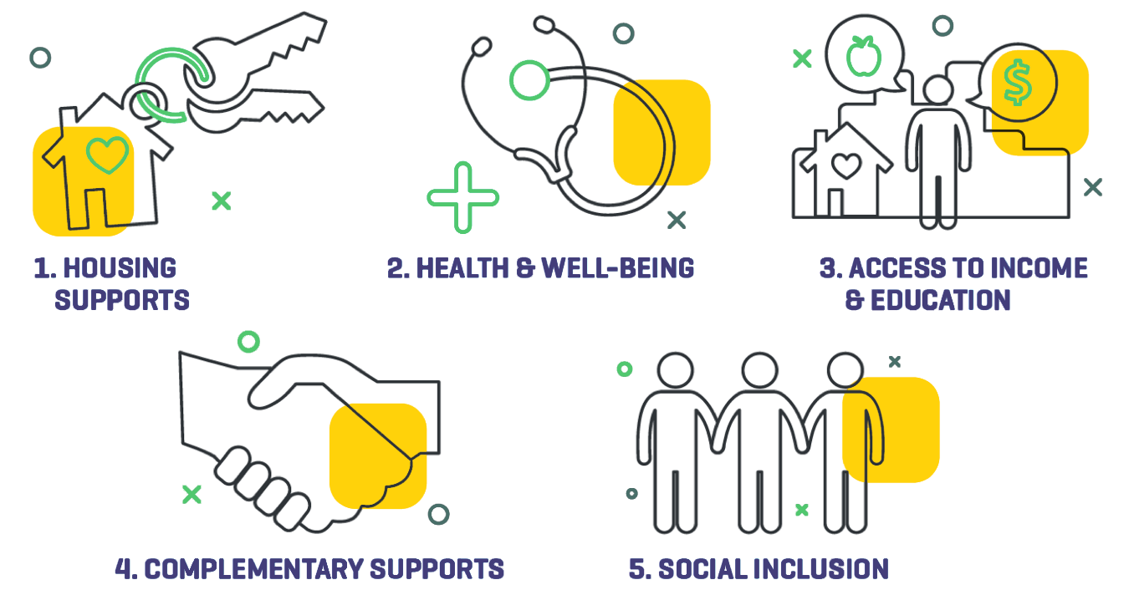
Areas of supports to enhance HOUSING STABILIZATION
for Housing First for Youth
The importance of developing a response based on the needs of developing adolescents and young adults
Notes:
Steve

Slide 72
Housing First for Youth
Demonstration Projects
Ottawa - Housing First for Youth
Kelowna - Housing First for Youth
Toronto - PREVENTION focus: Housing First for Youth leaving care
Hamilton - Housing First for Indigenous Youth (An Indigenous led project)
Notes:
MELANIE

Slide 73
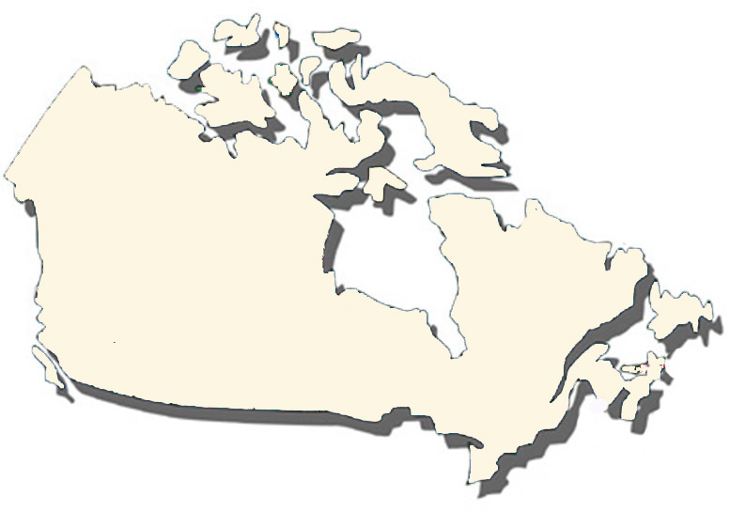
PREVENTION
Demonstration Projects
Enhancing Family and Natural Supports
Youth Reconnect
The Upstream Project
Notes:
MELANIE

Slide 74
Outcomes are tied to the service delivery models. Because the focus of these interventions is not just on independence, but on healthy transitions to adulthood, outcomes go beyond a simple measure of housing stability.

Slide 75
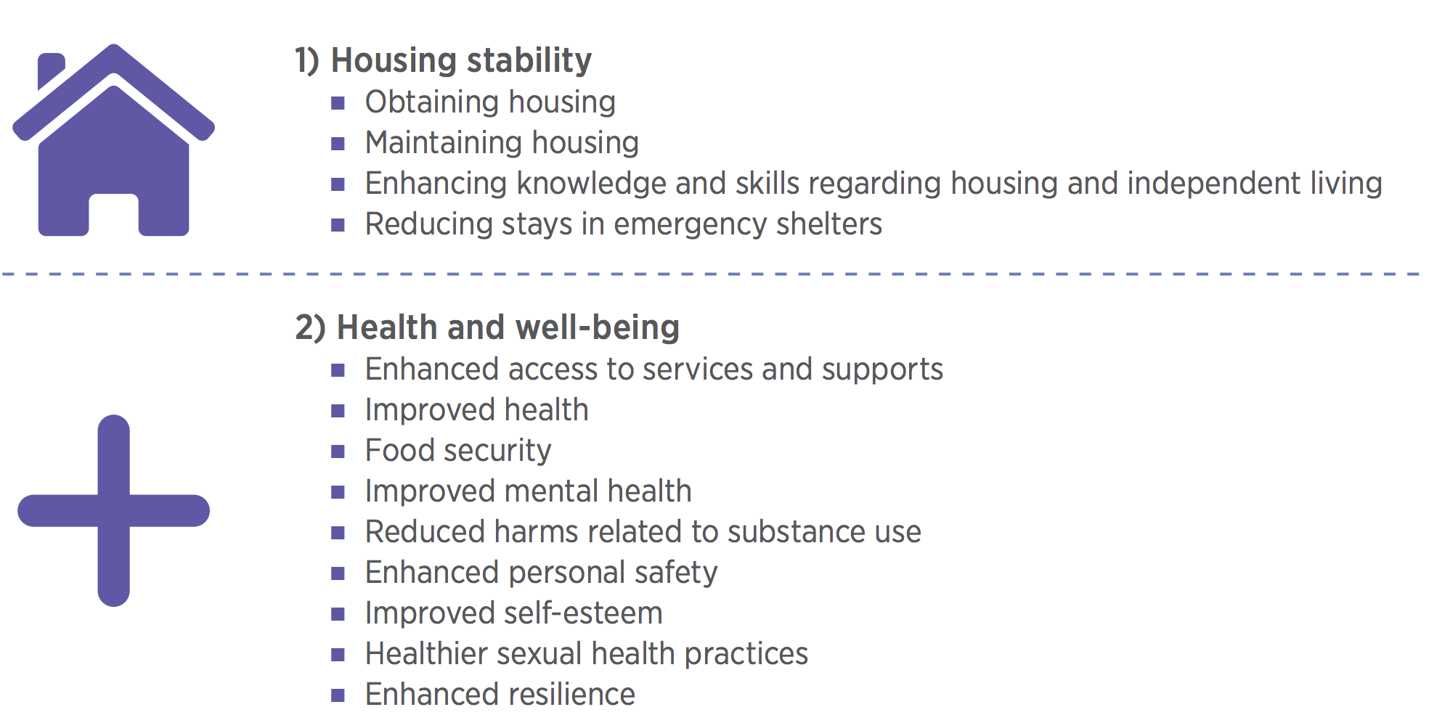
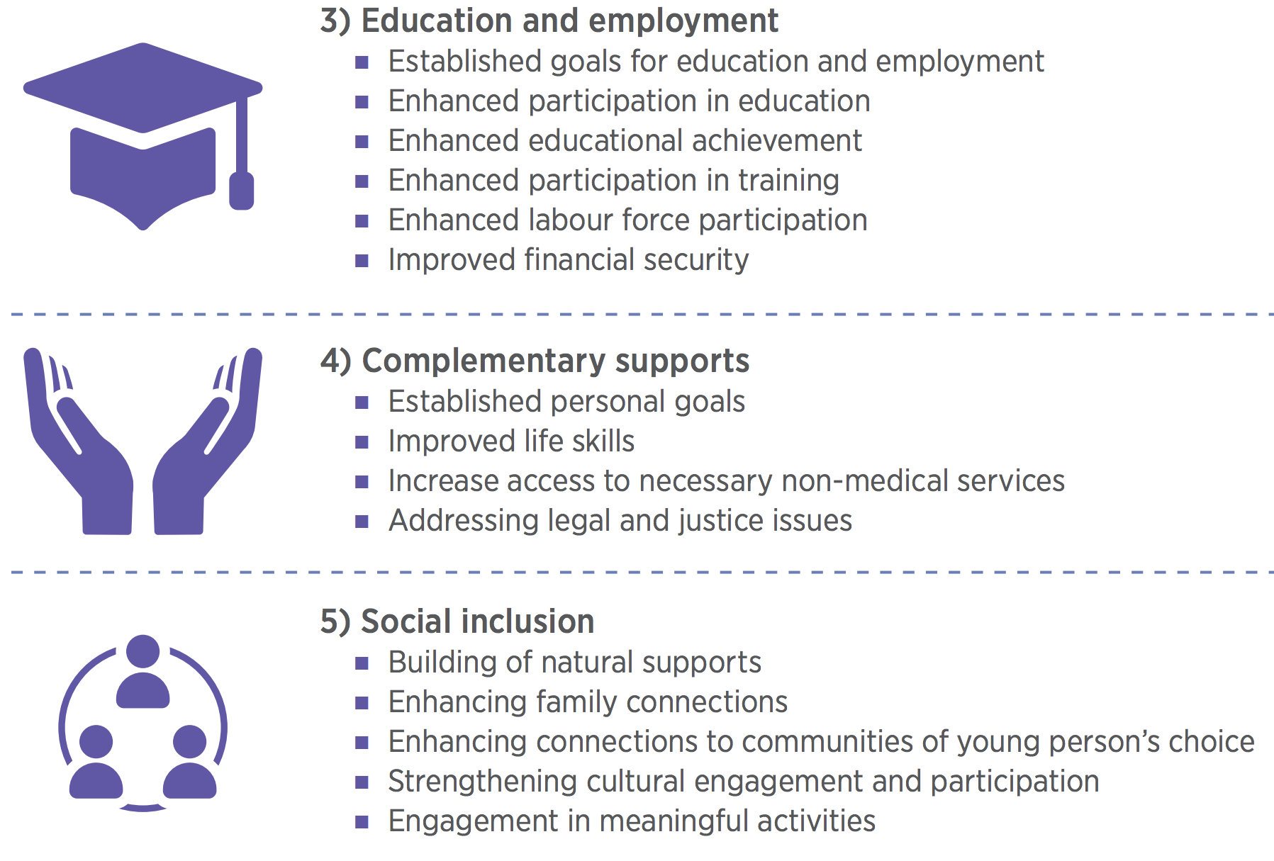
Notes:
STEVE

Slide 76
Part 7
Recognizing the opportunity

Slide 77
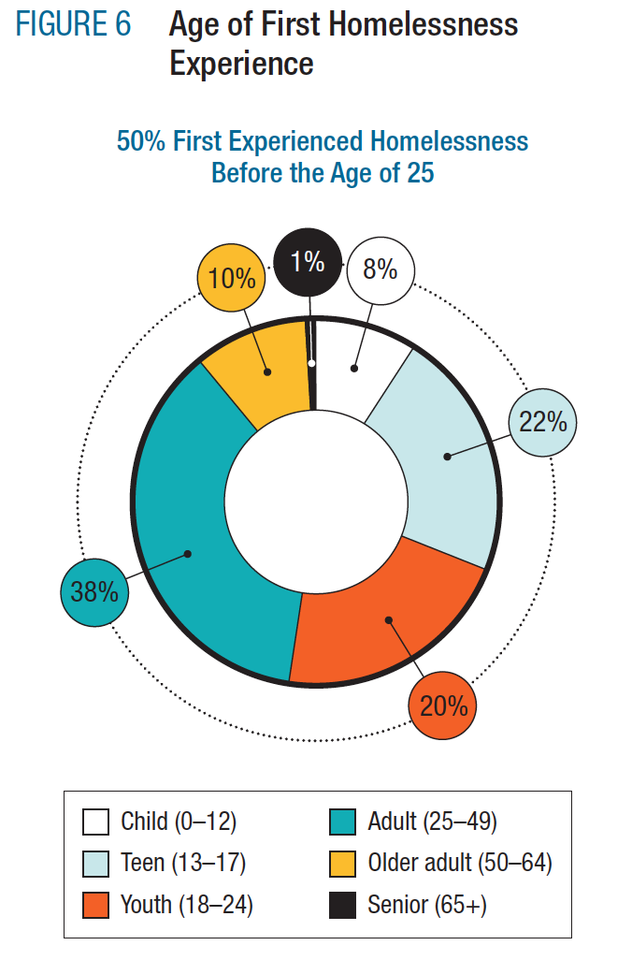

Slide 78
Mandatory Community Level Outcomes
Chronic homelessness in the community is reduced.
Homelessness in the community is reduced overall and for specific populations. (Communities choose as many as needed, but must include Indigenous homelessness).
New inflows into homelessness are reduced; and
Returns to homelessness are reduced.
PREVENTION!

Slide 80
KNOWLEDGE
MOBILIZATION
Creating Research Impact

Slide 81
The
CHALLENGE
In Canada and the United States, the prevention of homelessness is an afterthought
There is little homegrown knowledge about how to implement prevention
Funding and infrastructure not in place to support a shift to prevention
Lack of community capacity to successfully implement prevention
Opportunity cost: Doing prevention means stopping doing something else
Notes:
So the question is, what is the problem we are trying to solve?

Slide 82
The
CHALLENGE
The shift to prevention requires:
Policy and funding is aligned to support prevention
Knowledge base about how to do prevention is developed
Evidence for effective prevention is developed
Capacity building: Local government and not for profit sector are supported to make the shift
Need to shift hearts and minds: Just do it!
Notes:
So the question is, what is the problem we are trying to solve?

Slide 83
Influence and the Commitment Curve
Reflects change that may happen among or within organizations
The commitment curve is a way of assessing the commitment of stakeholders to changes in policy and practice.
It can be used to assess the degree to which target stakeholders are increasingly engaging and adopting practices aligned with AWH’s core outcomes over time.

Slide 84
So… How do we get there?

Slide 86
Communications Strategy

Slide 87
Resources
UPSTREAM
Family and Natural Supports
Youth Reconnect
HF4Y
Program Model Guide + Operations Manual
Notes:
The peer review process is integral to academic publishing as it ensures a high quality output. The COH has instituted a rigorous blind review process to our papers and books. Unlike the barriers associated with traditional academic publishing, the COH’s research is guided by an ‘open access’ policy in the hopes of increasing it’s reach.

Slide 88
Community Engagement
Notes:
The peer review process is integral to academic publishing as it ensures a high quality output. The COH has instituted a rigorous blind review process to our papers and books. Unlike the barriers associated with traditional academic publishing, the COH’s research is guided by an ‘open access’ policy in the hopes of increasing it’s reach.

Slide 89
Community Systems Planning
Notes:
Key to fostering scale and impact is systems planning and Government Relations.
Even the most innovative and evidence-based programs and policies operating in isolation will not lead to effective population level outcomes. AWH, COH and Turner Strategies have combined efforts to launch a “Systems Planning Collective” to help build the capacity for communities and all orders of government to ensure programs and policies focused on prevention and sustained exits are part of a systems approach and plan. The Collective’s work will help enable community uptake of what emerges from the MtS NCE.
For fostering scale & impact for Housing First for Youth in particular, government relations has been key. For example, in the U.S. we advised HUD and USICH concerning Housing First for Youth, and we’re also working with the Canadian federal government on directives for communities with the renewed Homelessness Partnering Strategy, Reaching Home, to ensure that Housing First for Youth programs funded by HPS are consistent with our model.

Slide 90
Government Relations
Notes:
Key to fostering scale and impact is systems planning and Government Relations.
Even the most innovative and evidence-based programs and policies operating in isolation will not lead to effective population level outcomes. AWH, COH and Turner Strategies have combined efforts to launch a “Systems Planning Collective” to help build the capacity for communities and all orders of government to ensure programs and policies focused on prevention and sustained exits are part of a systems approach and plan. The Collective’s work will help enable community uptake of what emerges from the MtS NCE.
For fostering scale & impact for Housing First for Youth in particular, government relations has been key. For example, in the U.S. we advised HUD and USICH concerning Housing First for Youth, and we’re also working with the Canadian federal government on directives for communities with the renewed Homelessness Partnering Strategy, Reaching Home, to ensure that Housing First for Youth programs funded by HPS are consistent with our model.

Slide 91
Events and Conferences
Revisiting and refreshing the Youth Rights! Right Now! Guide (2023)
International Forum on Transitions from Care (Spring 2023)
International Conference on Youth Homelessness Prevention (Spring 2024)
International Research Conference on Youth Homelessness Prevention (Spring 2025)
State of Systems Approaches to Youth Homelessness Prevention in the UNECE Region Report and International Convening (2024)
Notes:
The peer review process is integral to academic publishing as it ensures a high quality output. The COH has instituted a rigorous blind review process to our papers and books. Unlike the barriers associated with traditional academic publishing, the COH’s research is guided by an ‘open access’ policy in the hopes of increasing it’s reach.

Slide 93
International Profile of the work

Slide 94
Can we
END
youth homelessness?

